Slide 1
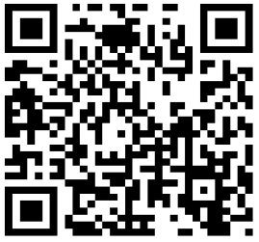
Access to TLQ
Login to
  https://onlinesurvey.cityu.edu.hk/
  Course Site on Canvas
Invitation email
  “Teaching and Learning Questionnaire (TLQ) – Your response matters”
Scan QR code

